Slide 1
CDR / SRM graphics

Slide 2
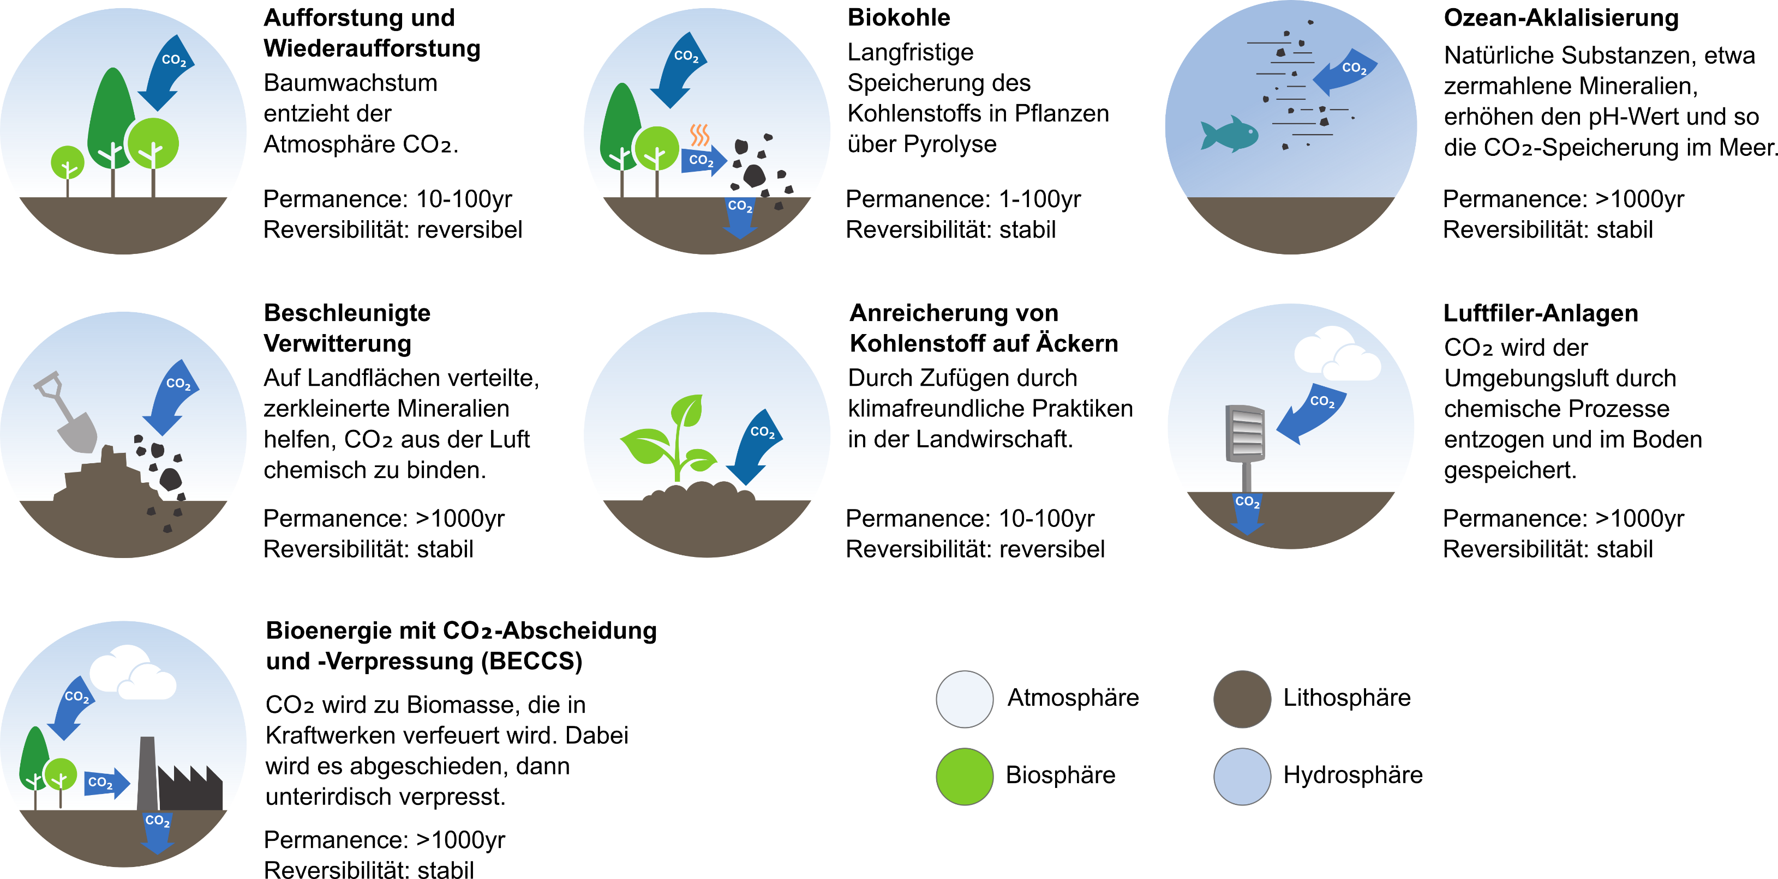
Existing work

Slide 3
Graphics to create in a similar style
First priority (required in a few weeks):
Stratospheric Aerosol Injection
Marine Cloud Brightening
Space-based Geoengineering
Second priority (no deadline):
Ecosystem/peatland restoration
Harvested wood products
Cirrus cloud thinning
Ice protection
Surface based albedo modification

Slide 4
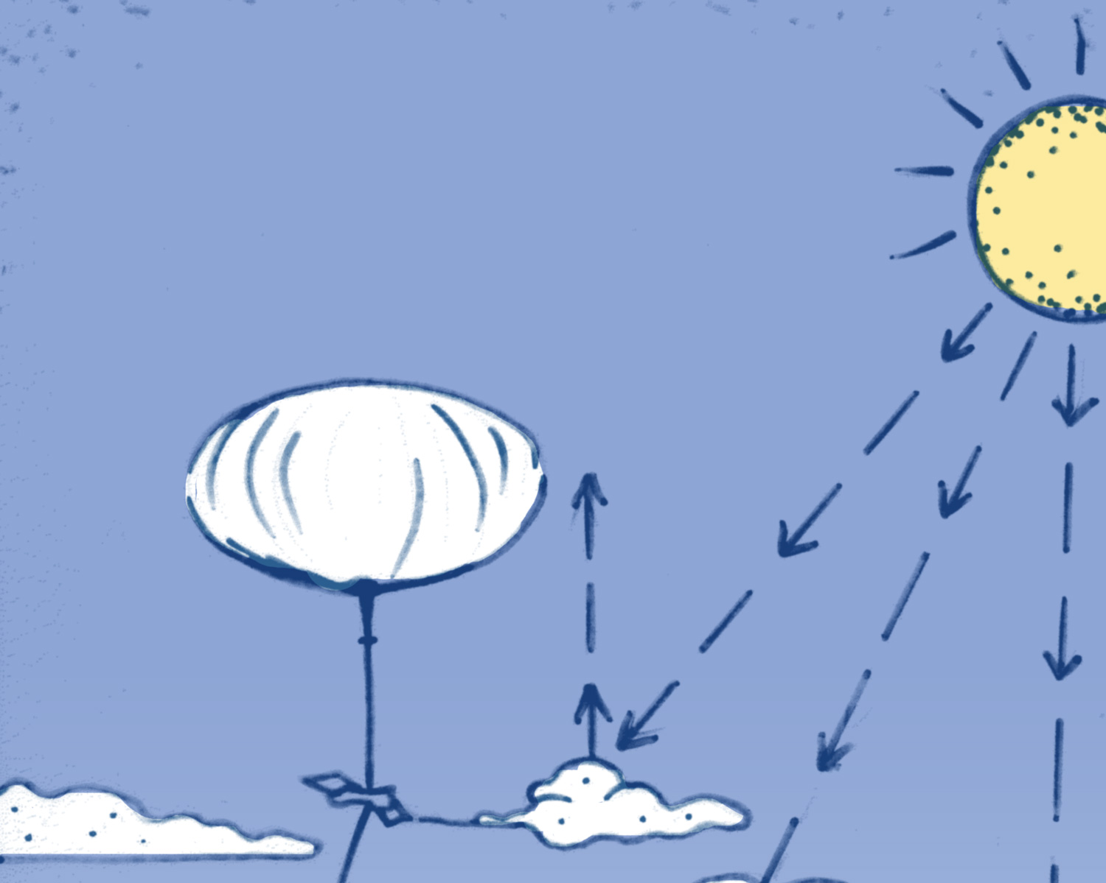
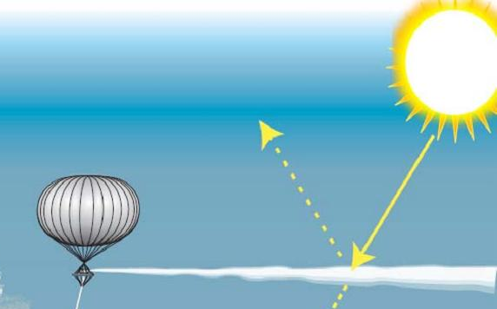
Stratospheric Aerosol Injection
Stratospheric Aerosol Injection – Stratospheric aerosol injection aims to limit the effects of climate change by using planes or balloons to spray small particles of substances (aerosols) into the upper atmosphere. Sulfur dioxide is one example of a substance we could use. The particles would reflect sunlight back into space. This could cool temperatures on Earth. But for this idea to work, we would have to keep doing it continuously. If we stopped, temperatures would rise once again, and probably very quickly, Also, stratospheric aerosol injection would not do anything to reduce our greenhouse gas emissions or help with other impacts, such as ocean acidification.
Notes:
Source (left): https://en.wikipedia.org/wiki/Stratospheric_aerosol_injection#/media/File:SPICE_SRM_overview.jpg (CC BY-SA 3.0)
Source (right): https://www.geoengineeringmonitor.org/2021/02/stratospheric_aerosol_injection/

Slide 5
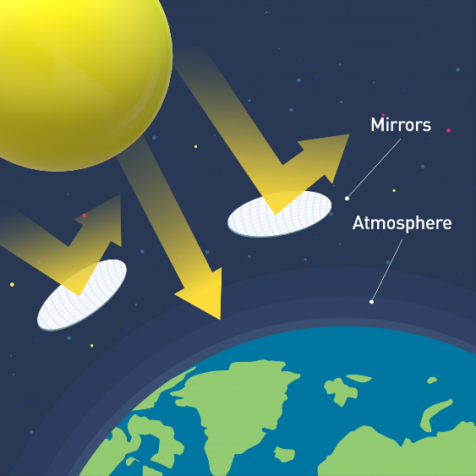
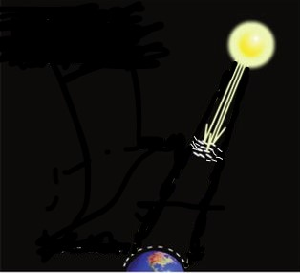
Space-based geoengineering
Space-based Geoengineering – Space-based geoengineering aims to limit the effects of climate change by putting a giant mirror or other reflective material in outer space between the Earth and the sun. Such a space mirror or sunshield would deflect sunlight back into space. This could cool temperatures on Earth. Space-based geoengineering also would avoid direct changes to the land, oceans, or atmosphere of the Earth itself. But for this idea to work, we would need to be able to build and maintain something in space much larger than ever before. A space mirror would also be very costly to build, given that its location would be about four times as far from the Earth as the Moon. Also, it would not do anything to reduce our greenhouse gas emissions or help with other impacts, such as ocean acidification.
Notes:
Source (left): re-drawn based on futurism.com
Source (right): https://www.geoengineeringmonitor.org/2021/02/stratospheric_aerosol_injection/

Slide 6
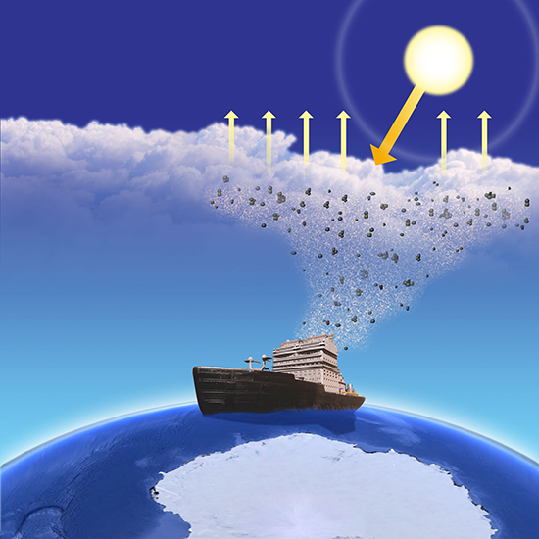
Marine cloud brightening
Marine Cloud Brightening – Marine cloud brightening aims to limit the effects of climate change by spraying small particles of substances, such as sea salt, into the air over the oceans, to make clouds brighter. These clouds would reflect sunlight away from the Earth, which could cool temperatures on a local or regional level. Marine cloud brightening might also help to protect ecosystems threatened by climate change. One way to spray the particles would be to use a fleet of ships. But for this idea to work, we would have to keep doing it continuously. If we stopped, temperatures would rise once again, and probably very quickly. Also, marine cloud brightening would not do anything to reduce our greenhouse gas emissions or help with other impacts, such as ocean acidification.
Notes:
Source: https://climatemodeling.science.energy.gov/research-highlights/bright-side-arctic-clouds

Slide 7
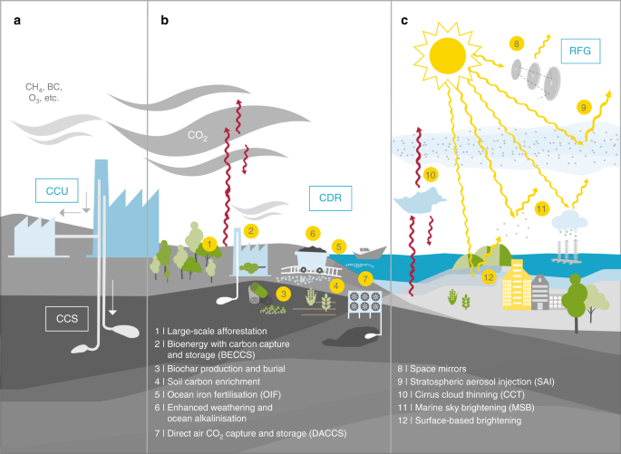
Other ideas from literature
Notes:
Source: https://www.nature.com/articles/s41467-018-05938-3

Slide 8
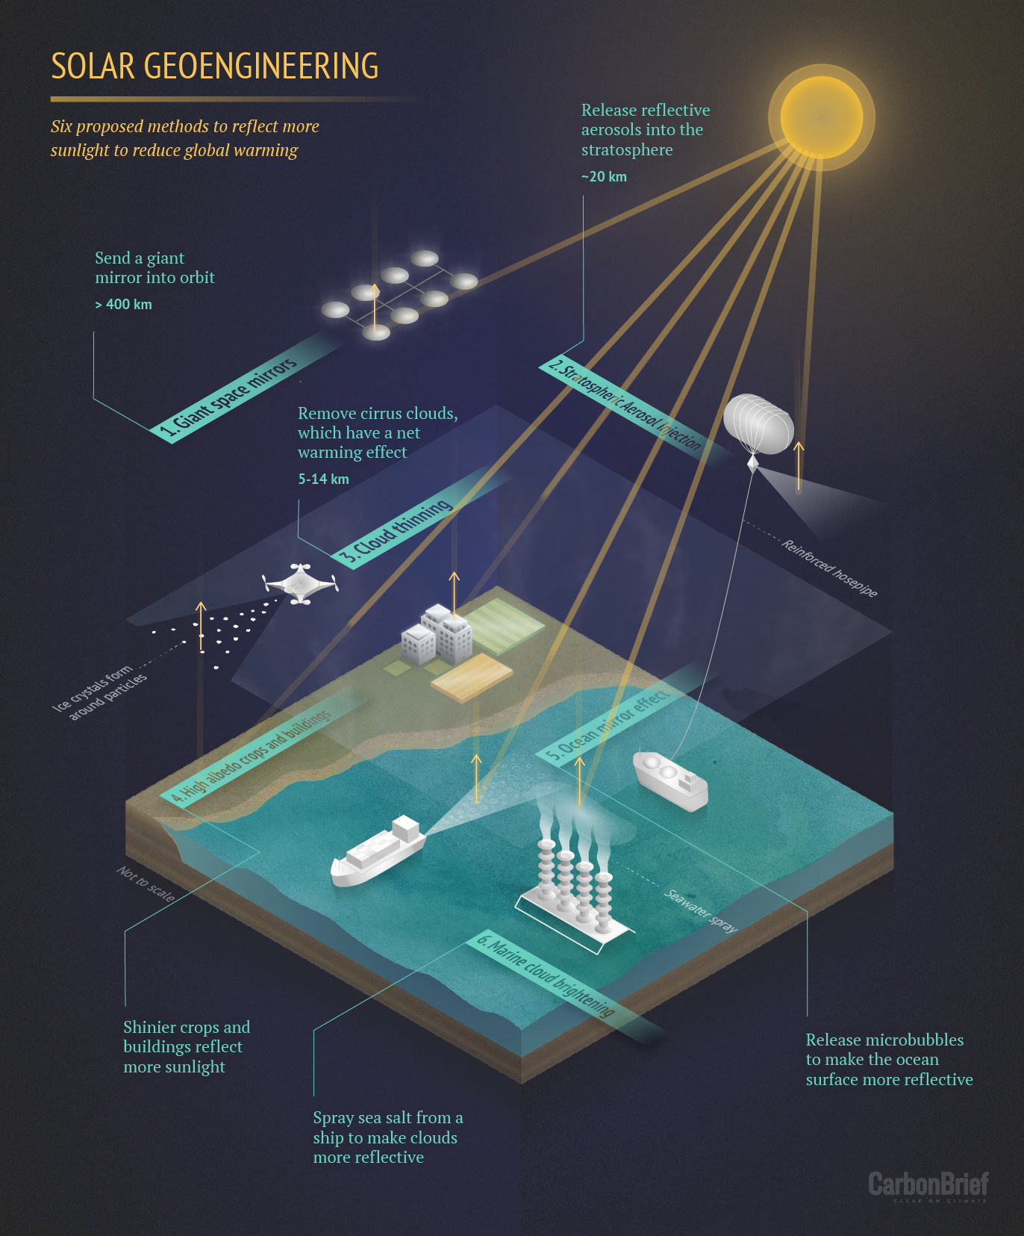
Other ideas from literature
Notes:
Source: https://www.carbonbrief.org/solar-geoengineering-may-not-cool-the-oceans-study-says/

Slide 9
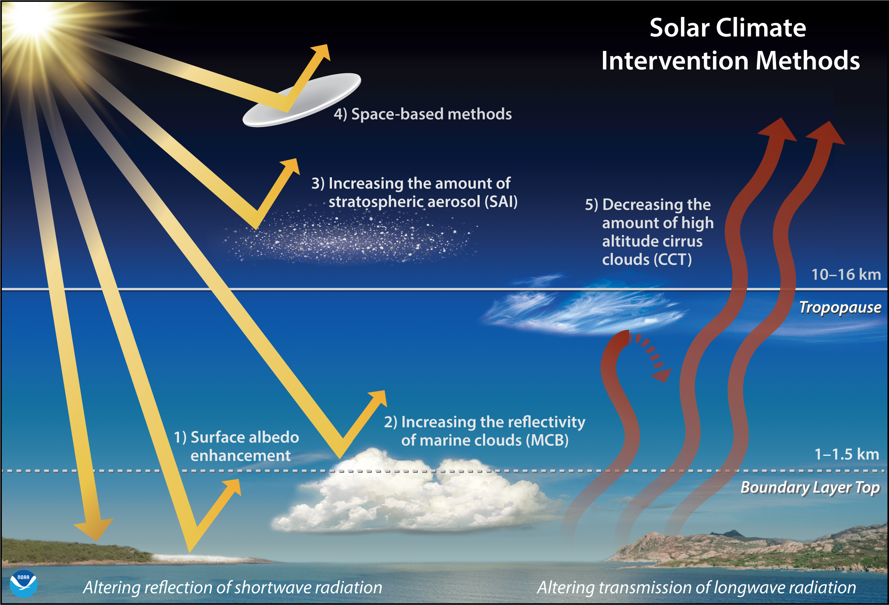
Other ideas from literature
Notes:
Source: https://research.noaa.gov/article/ArtMID/587/ArticleID/2756/Simulated-geoengineering-evaluation-cooler-planet-but-with-side-effects

